Slide 1

AMERICAN INTERNATIONAL UNIVERSITY – BANGLADESH
APPLYING AUGMENTED REALITY IN BANGLADESH MAP

Slide 2
Supervised By Dr. Md. Abdullah-Al-Jubair Assistant Professor Department of Computer Science AMERICAN INTERNATIONAL UNIVERSITY-BANGLADESH (AIUB)
Group Members:
Name | ID
Shanzida Afroza Shatu | 17-34583-2
Janaatul Ferdoush | 17-34608-2
Md. Atik Hasan | 17-35834-3
Md. Dipu Hasan | 18-36364-1

Slide 3
Overview
Questionnaire Development
Statement Analysis
Findings
Contribution of the Study
Significance of the Study
Limitation
Future Work
Conclusion
Reference
System Demo
Introduction
Background Study
Problem Statement
Research Objective
Literature Review
Methodology
Development Methodology
Implementation
Evaluation

Slide 4
Introduction
AR technology provides a latest way to guide students.
Maps represent information about the world in a simple and easy way.
An interactive map will help the users to navigate safely.
The purpose of this study is to design and develop an AR framework in Bangladesh Map and to find out the effectiveness of AR based Bangladesh Map by conducting a survey to know about Bangladesh properly.

Slide 5
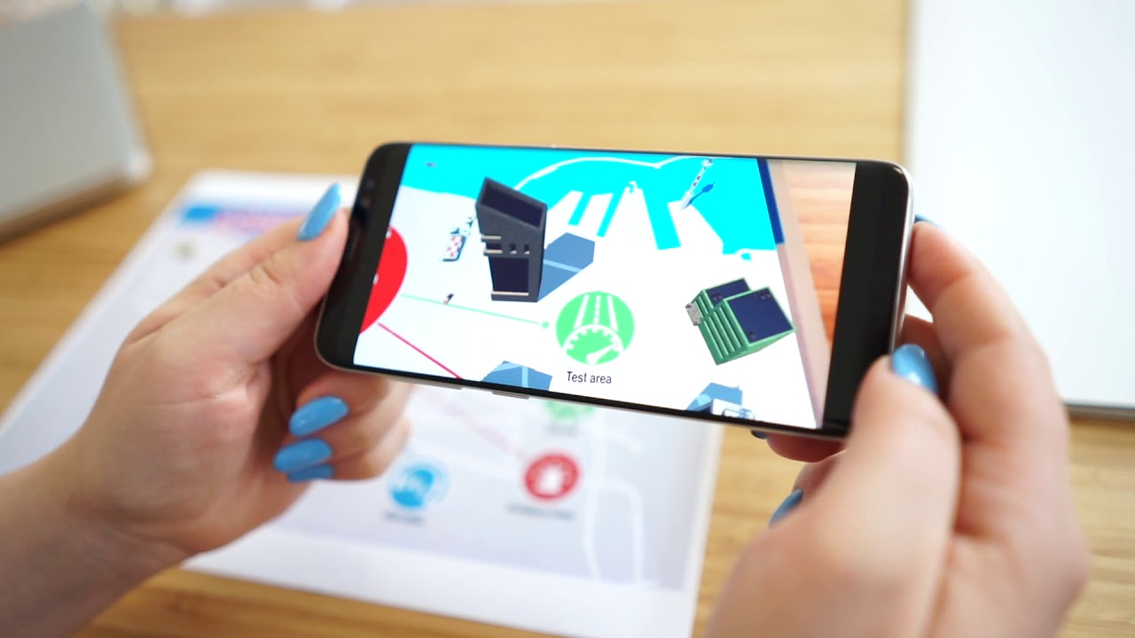
AR Map

Slide 6
Background Study
Description | Author Name
The main aim of AR is to enhance user’s view of the world that merges digital information by improving the ability to overlay virtual objects on the real world. | Billinghurst, 2002
A commonly known concept of ‘Mediated Reality’ is related to AR where real view is altered, augmented by a computer. | Hassan & Ramkissoon, 2016
AR Merges with Real & Virtual World | Carmigniani & Furht, 2011

Slide 7
Problem Statement
Traditional map are not too much interactive for tourists.
In printed copies of a map, the details are uninformative to the tourists.
Difficult to extract correct relevant information from the map
The significance of any attractive place can’t be explained properly with the traditional printed map.
It will not too much impressive in real life.

Slide 8
Research Objective
General Objective
To introduce new technology
To apply Augmented Reality in tourism sector
Specific Objective
To design an AR framework for Bangladesh map
To develop an AR based system using Vuforia library and Unity Game Engine for Smartphone’s
To evaluate the system to find out the effectiveness of AR
To conduct a survey among AIUB students

Slide 9
Literature Review
Description | Author Name
The perception of the user, better acknowledgement about the surroundings and the interaction with the surroundings can be improved by Augmented Reality. | Iftene & Trandabat, 2018
For the advancement of emerging technological fields, usable AR applications such as authoring tools, tracking mechanism, display systems and input devices can be created to solve many technological issues. | Billinghurst, 2002
AR can simplify the user’s life by introducing virtual information from the actual world. | Carmigniani & Furhut, 2011
Augmented Reality permits the user to observe the actual world with virtual surroundings overlaid on it. | Azuma, 1997

Slide 10
Literature Review
Description | Author Name
Computer vision is the advancement of augmentation that happens in actual time which determines that users are conscious of being in the actual world | Azuma, 1997
Now-a-days, the combination of AR with the surgical navigation system aims to improve the safety and reliability of surgery by implementing an optical see-through HMD | Chen et al., 2015
The primary occurrence of mobile AR can certainly be related with the improvement of the wearable AR, in a sense of experiencing AR during locomotion | Arth et al., 2015
Mobile Augmented Reality is perhaps the most unstable development region for AR applications right now | Criag, 2013

Slide 11
Methodology
Introduce an AR framework which enhances the understanding of the tourists
The main purpose of this study is to develop 3D virtual object and multimedia generation and implement them in Vuforia library
Research methodology has been discussed in two parts
Development Methodology
Testing Methodology

Slide 12
Development Methodology
The development strategy for this study relied on System Development Life Cycle (SDLC)
There are five stages within the development methodology-
Planning
Requirement Gathering & Analysis
Development & Implementation
Testing
Deployment

Slide 13
Development Methodology
SDLC
Planning
Requirement Gathering & Analysis
Development & Implementation
Testing
Deployment
Software Development Life Cycle (SDLC)

Slide 14
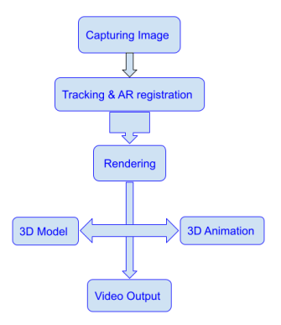
Framework

Slide 15
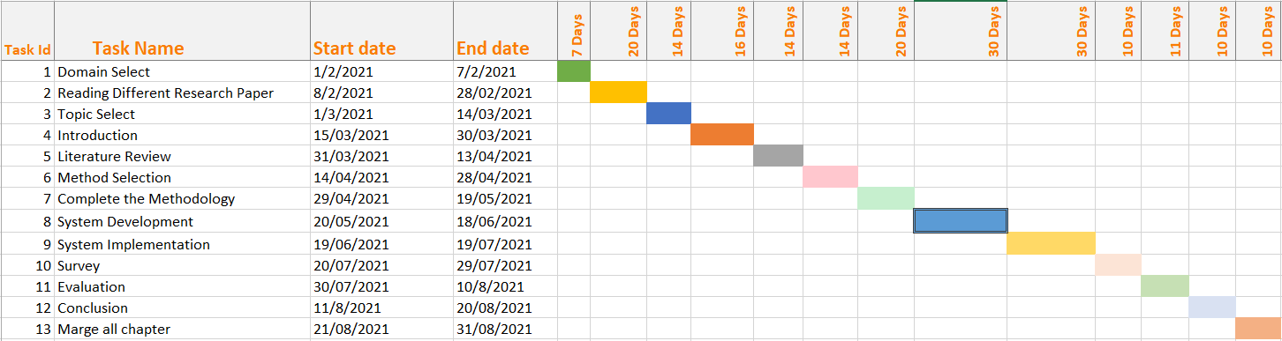
Work Planning and Execution
Gantt Chart

Slide 16
Budget
Equipment | Price (taka)
Computer | 50,000
Accessories | 500
MAP | 50
Smart Phone | 20,000
Total price | 70,550

Slide 17
Implementation
In this study, we have used Vuforia as tracking library to develop our Augmented Reality based Bangladesh Map.
An android smart phone’s built-in Android camera API is utilized to integrate the Vuforia tracking library for capturing the video.
Unity game engine is also used to create 2D and 3D multimedia generations.

Slide 18
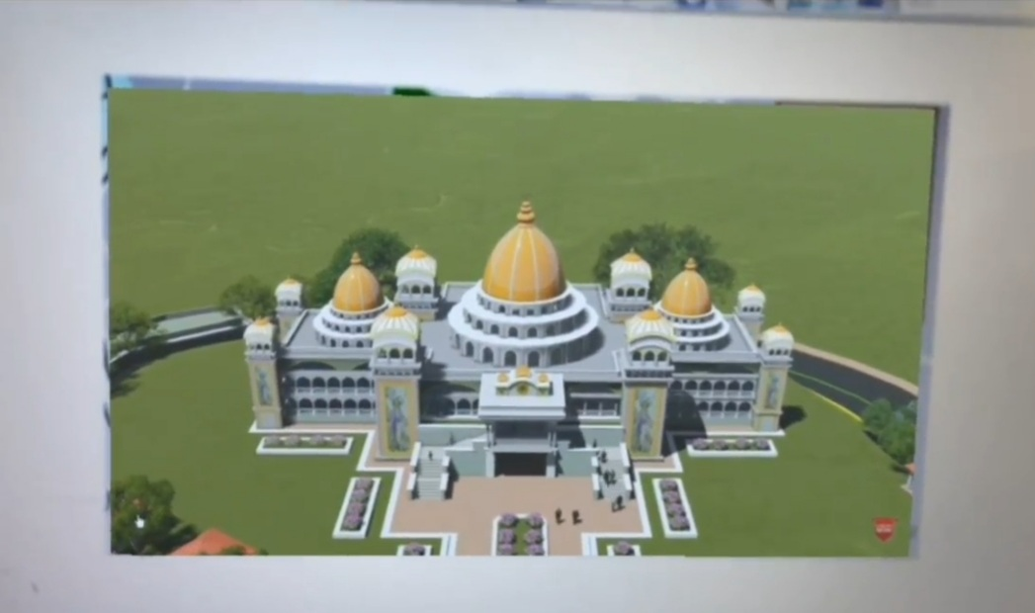
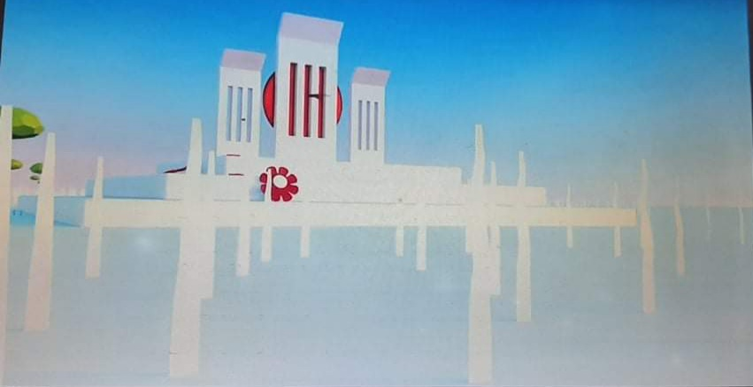
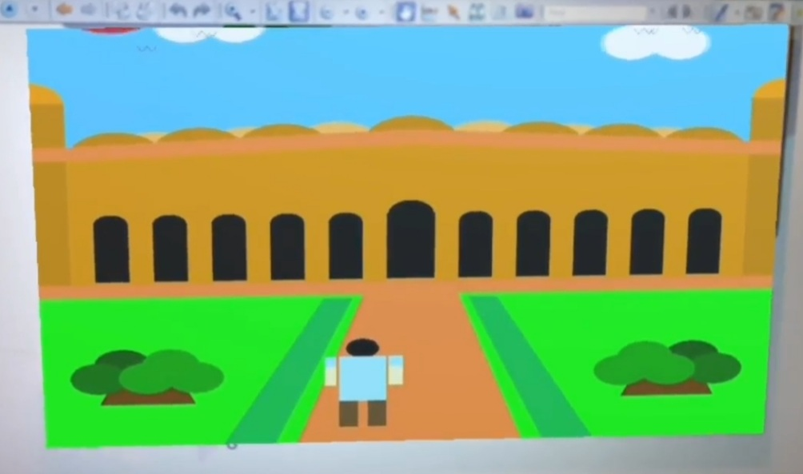
3D Generation
There are ten 3D graphics we have used in our system
3D graphics are built and coordinated by utilizing Unity & OpenGL
AR application detects the marker by scanning the target image

Slide 19

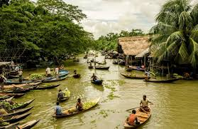
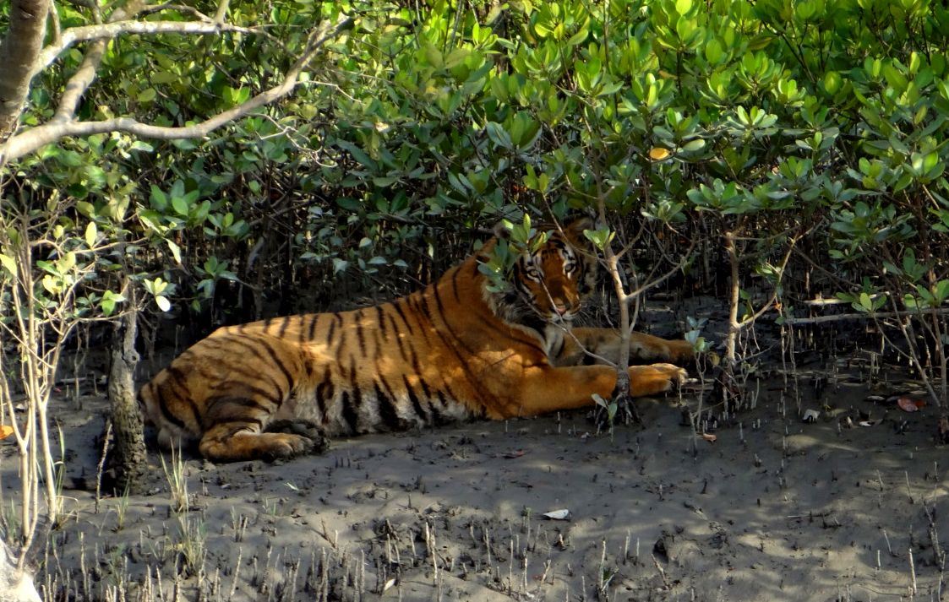
2D Generation
We have also used some 2D graphics in our system
2D graphics are gathered from web and composed into the structure by utilizing Unity

Slide 20
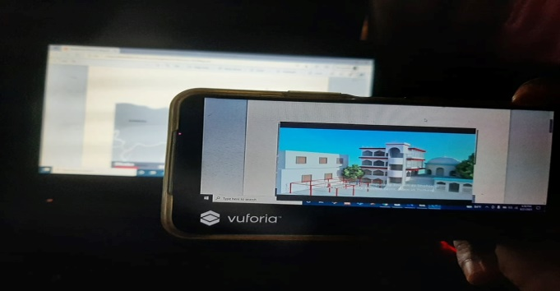
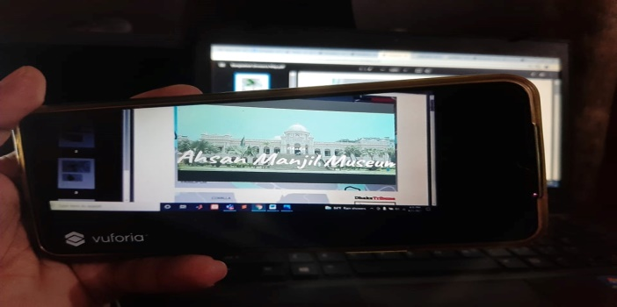
Multimedia Generation

Slide 21
Evaluation
The main goal of evaluation part is to find out the effectiveness of the mobile AR system in Bangladesh Map to boost up the tourism sector.
We have developed a questionnaire by to know the effectiveness of the system.
55 participants have participated in the survey.
All of them are from AIUB.

Slide 22
Questionnaire Development
A total of 2 questionnaires were collected and analyzed.
This survey was created in online.
Online (web URL) version was distributed to the users for data collection.
Help from individuals and social networking platforms (Facebook, WhatsApp) were taken to reach the students.

Slide 23
Statement Analysis
Respondent’s response to the General Performance Questionnaire
No. | Statement | Response
 |  | Yes | No
1 | Did you ever use the Augmented Reality technology before? | 14 (25.5%) | 41 (74.5%)

Slide 24
Statement Analysis
No. | Statement | Response
 |  | Strongly Agree | Agree | Neutral | Disagree | Strongly Disagree
2 | The AR technology has the effectiveness to expand the tourism sector in Bangladesh. | 32 (58.2%) | 17 (30.9%) | 6 (10.9%) | 0 (0%) | 0 (0%)

Slide 25
Findings
Almost 75% participants did not use the augmented reality technology before.
Most of the participants (89.1%) agreed that augmented reality technology can effectively expand the tourism sector in Bangladesh.
10.9% of contributors were neutral in their decision.
This can be concluded from the findings that the implementation of mobile AR system was successful

Slide 26
Contribution of the Study
We are developing a mobile AR system in Bangladesh Map.
Want to find out the effectiveness of AR technology
Introducing Augmented Reality technology in Bangladesh Map
This mobile AR system will be an interactive way for the tourists to retrieve information for the map.

Slide 27
Significance of the Study
Helpful for an unknown tourist to find out the important place.
Creates a great step against the manual map searching process.
Contributes to our economical development.
Representation of our country in front of other nations will be easier.

Slide 28
Limitation
Cannot be possible to include more locations of the tourist places.
When the picture quality is not good enough in that case the image detection problem is an issue.
When the camera angle of android device is not suitable then the image of map cannot be detected accurately.

Slide 29
Future Work
Suggestion to provide audio instructions for visually impaired people
Suggestion to improve the camera app quality
Suggestion to include large number of input data
Suggestion to add multiple buttons in the system
Suggestion to import the precise tracking library

Slide 30
Conclusion
A mobile AR system was developed to extract relevant information for the tourists while visiting our country
System Development Life Cycle (SDLC) was used as system development methodology to develop 3D visualization in this mobile AR system.
The evaluation result showed that the integration of AR system was successfully implemented.
Some new features can be added in the existing system for future work.

Slide 31
Reference
Billinghurst, M. (2002). Augmented Reality in Education. Retrieved from http://www.newhorizons.org
Hassan, A. & Ramkissoon, H. (2016). Augmented reality application for visitor experiences: Examples and replication. Retrieved from https://www.researchgate.net/publication/303923635_Augmented_reality_application_for_visitor_experiences:_Examples_and_replication.
Carmigniani, J. & Furht, B. (2011). Augmented Reality: An Overview. Retrieved from https://www.researchgate.net/publication/227164365_Augmented_Reality_An_Overview.
Iftene, A. & Trandabat, D. (2018). Enhancing the Attractiveness of Learning through Augmented Reality. International Conference on Knowledge Based and Intelligent Information and Engineering Systems, 166-175.
Azuma, R. T. (1997). A Survey of Augmented Reality. Massachusetts Institute of Technology, Cambridge, USA, 355-385.

Slide 32
Reference
Chen, X. ,Xu, L. , Wang, Y. , Wang, H. , Wang, F. , Zeng, X. Wang, Q. & Egger, J. (2015). Development of a surgical navigation system based on augmented reality using an optical see-through head-mounted display. Journal of Biomedical Informatics, 55, 124-131. http://dx.doi.org/10.1016/j.jbi.2015.04.003.
Arth, C. , Gruber, L. , Grasset, R. , Langlotz, T. , Mulloni, A., Schmalstieg, D. & Wagner, D. (2015). The History of Mobile Augmented Reality. Inst. for Computer Graphics and Vision, Graz University of Technology, Austria.
Craig, A.B.(2013). Mobile Augmented Reality. Understanding Augmented Reality (pp.1-12). Retrieved from https://www.elsevier.com/books/understanding-augmented-reality/craig/978-0-240-82408-6

Slide 33


Slide 34


